Slide 1
CIKM MMSR '24
CBVS: A Large-Scale Chinese Image-Text Benchmark for Real-World Short Video Search Scenarios
Xiangshuo Qiao^{1,†},Xianxin Li^{1,†},Xiaozhe Qu¹,JieZhang ^{1,∗},Yang Liu¹,YuLuo ¹, Cihang Jin¹ andJinMa ²
1 Tencent PCG, Beijing, China
2 University of Science and Technology of China, Hefei, Anhui, China
∗Corresponding author.
†These authors contributed equally.

Slide 2
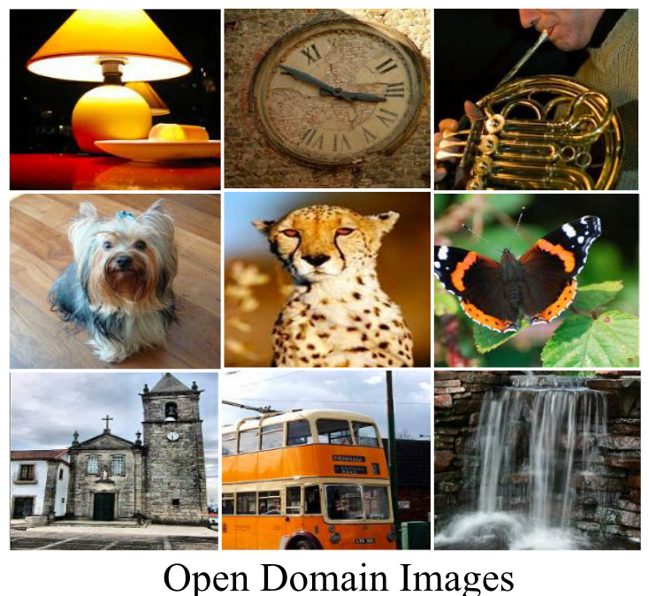

Background
Why do we need video covers?
However, there is a significant difference between images for pre-training and video covers.
Most of the images for pre-training are presented in the form of open domain common-sense visual elements. Differently, video covers in short video search scenarios are presented as user-originated contents that provide important visual summaries of videos.
In addition, a portion of the video covers come with manually designed cover texts that provide semantic complements. However, there is a phenomenon of missing video covers, and existing models have not taken this issue into consideration.

Slide 3
Overview of Our Work
In order to fill in the lack of cover data for short video search scenarios, we release the largest Chinese cover image-text dataset with video title texts and cover texts.
2. We build a manual fine-labeling image-text benchmark test for Chinese short
video search scenarios, containing real user queries from browser logs.
3. We propose UniCLIP, which introduces an image classification task and an image-
text matching task to guide image-text contrastive learning training. UniCLIP imposes
no additional inference cost and training is immune to the modality missing problem.
dataset, code and checkpoints are available at
https://github.com/QQBrowserVideoSearch/CBVS-UniCLIP

Slide 4
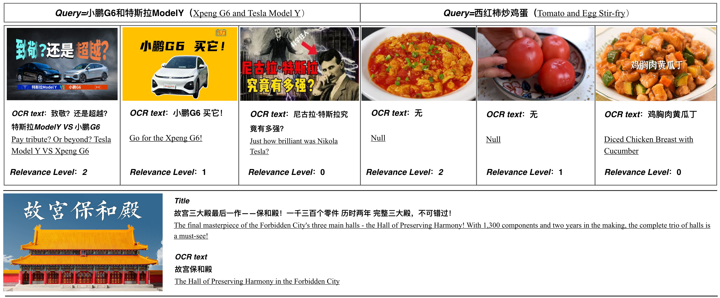
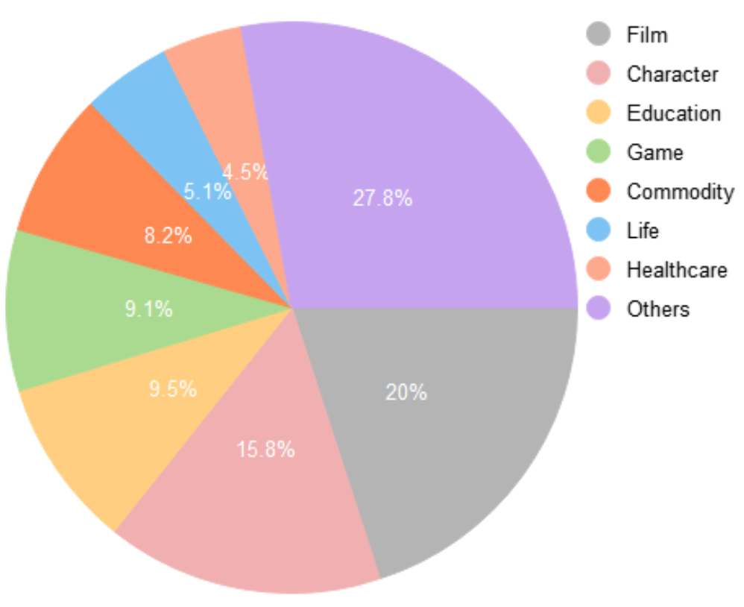
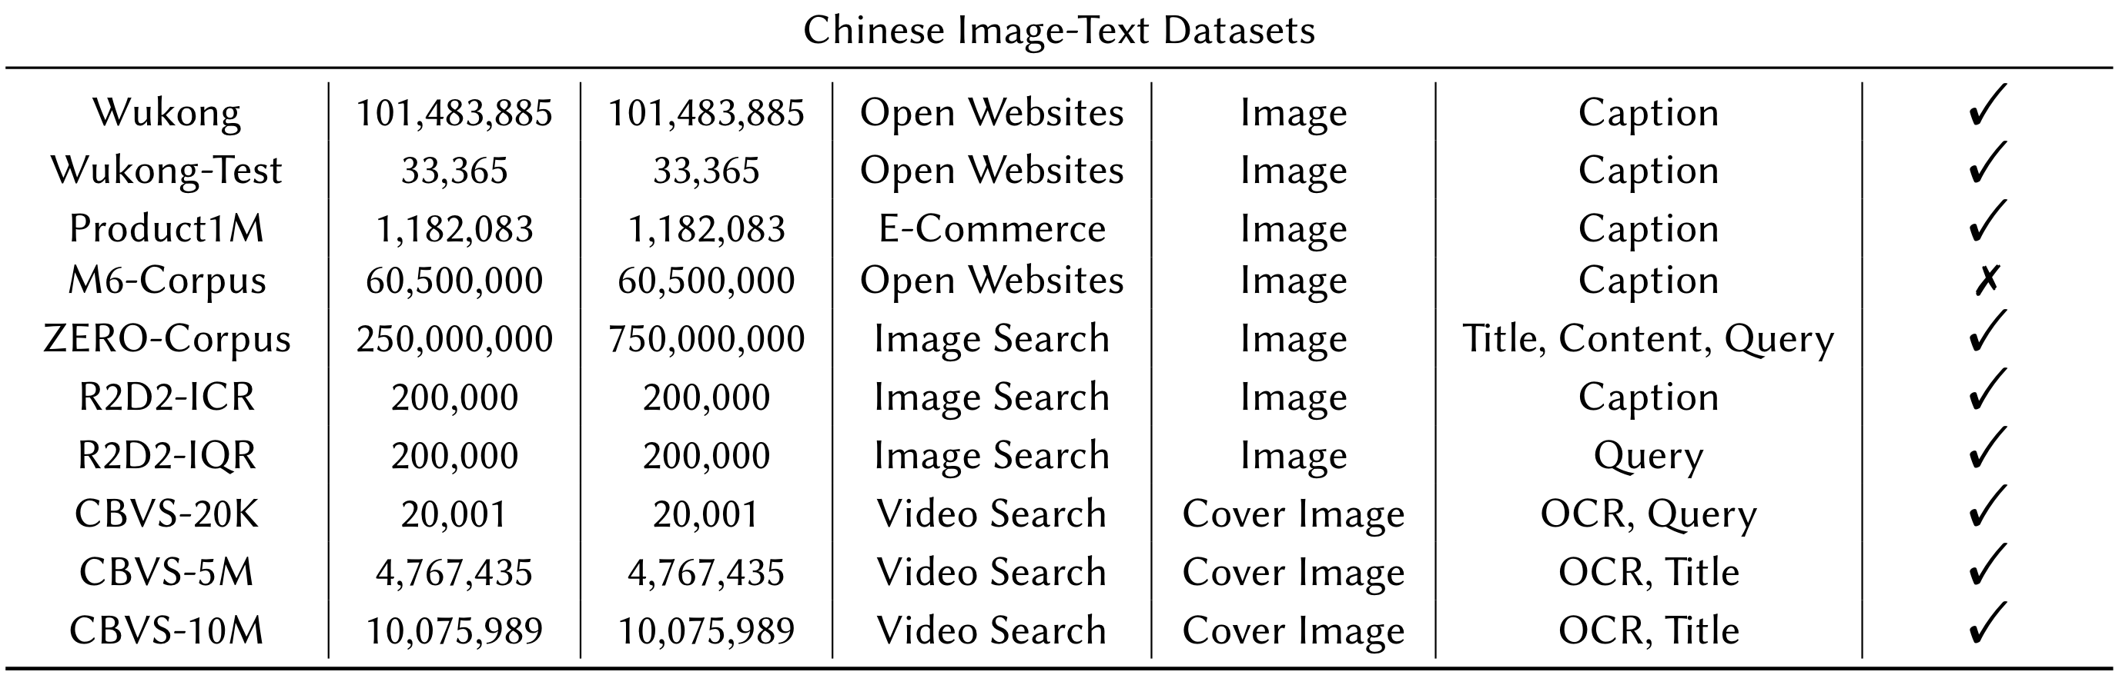
Dataset Construction：CBVS
Top:
Presentation of CBVS-20K data.
Bottom:
Presentation of CBVS-5M/10M data.
Distribution of categories of user queries in CBVS-20K.

Slide 5
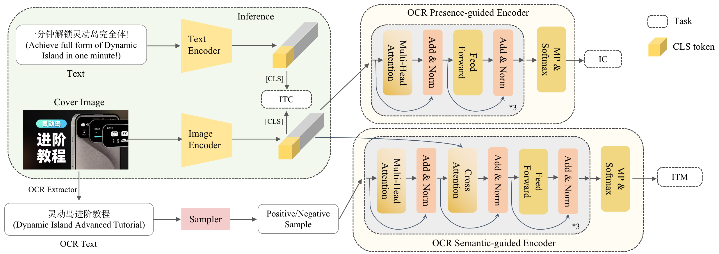
Model Construction：UniCLIP
Model structure of UniCLIP. When the model performs inference, only the green area works.
ITC stands for ”Image-Text Contrastive” IC stands for ”Image Classification” , and ITM stands for ”Image-Text Matching” . 𝐿_{𝐼𝑇𝐶} and 𝐿_{𝐼𝑇𝑀} are computed in the same way as ALBEF. 𝐿_{𝐼𝐶} is realised by the binary cross entropy function.
𝐿_{𝐼𝑇𝐶} is the core task of the image-text contrastive learning, 𝐿_{𝐼𝐶} and 𝐿𝐼_{𝑇𝑀} are used for guidance.

Slide 6
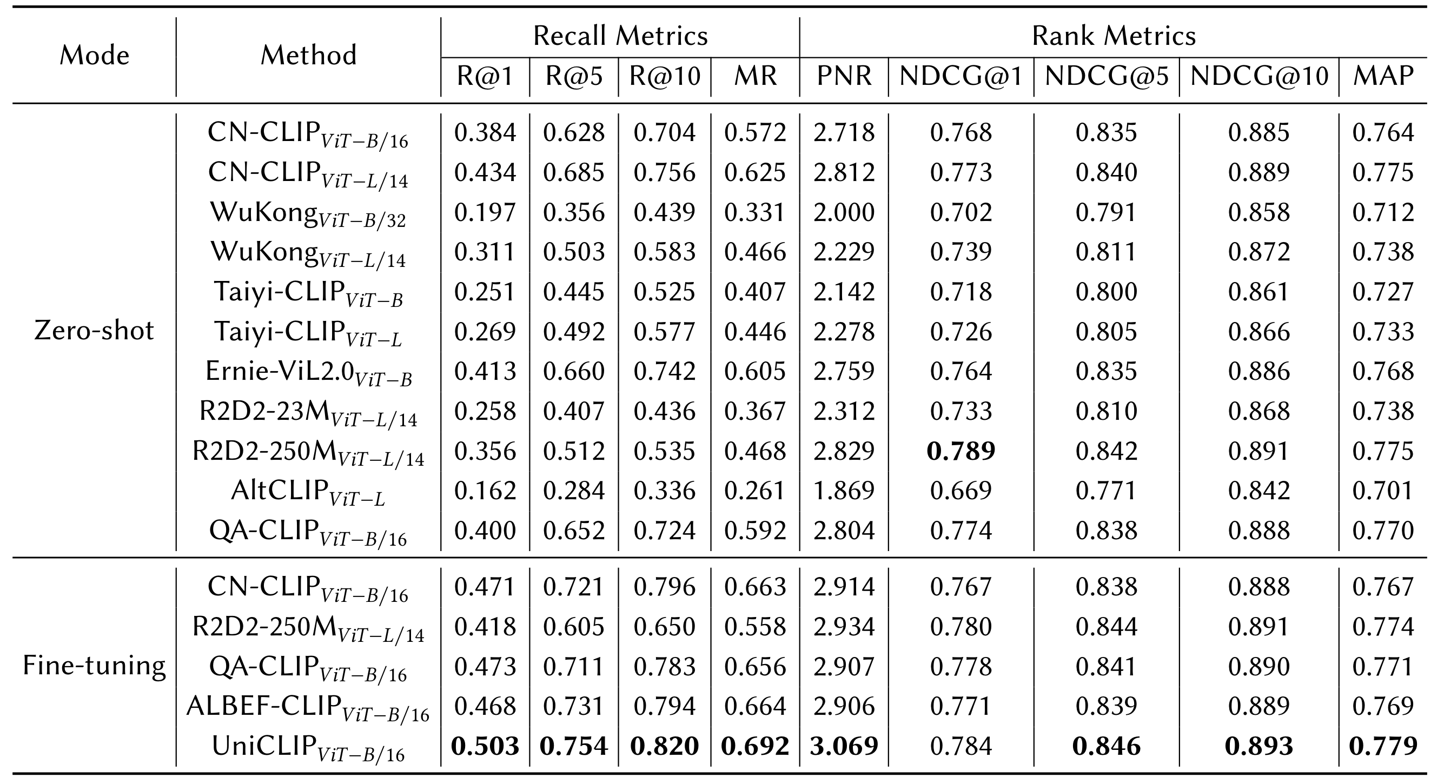
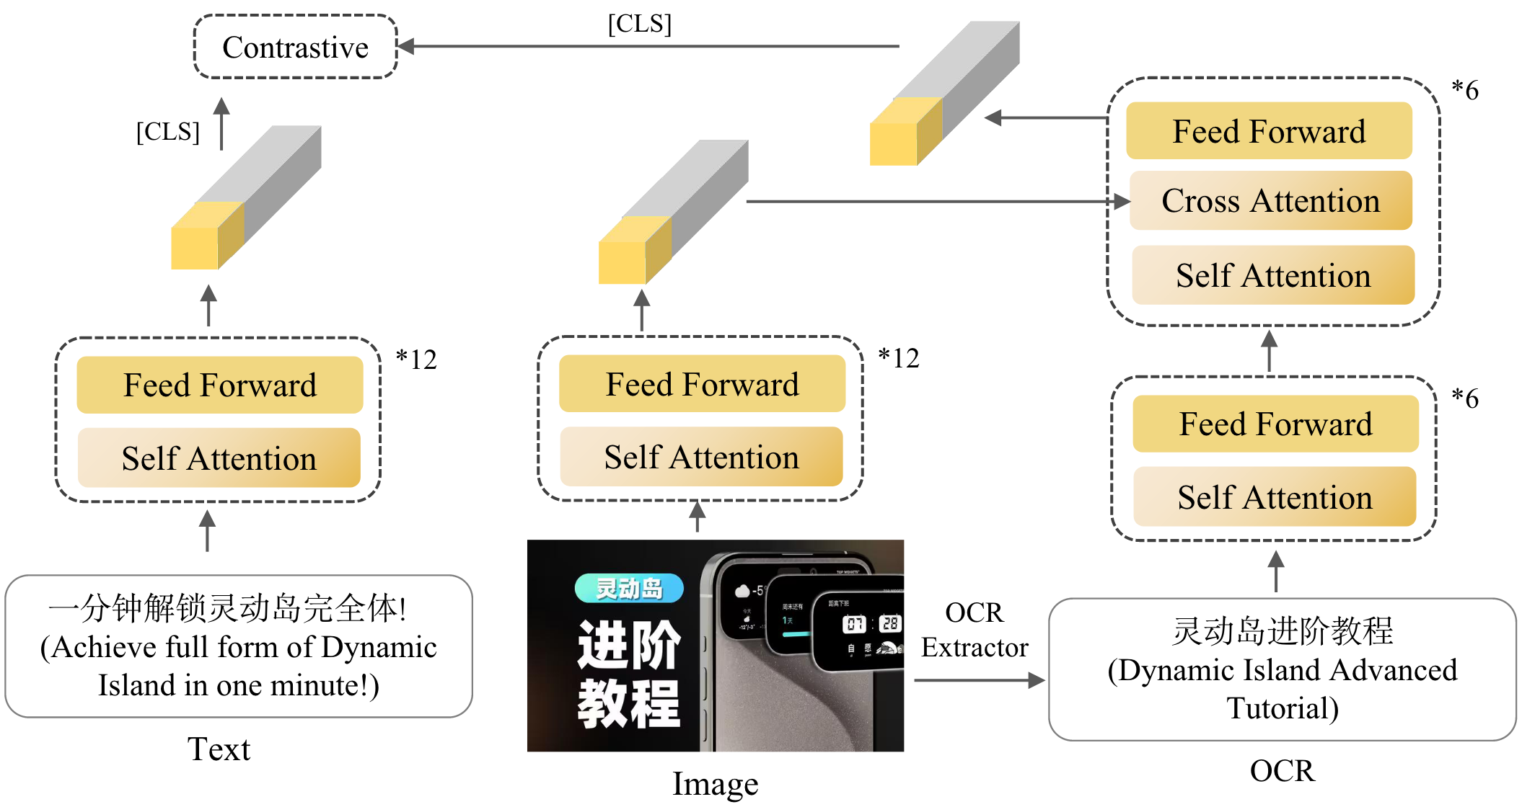
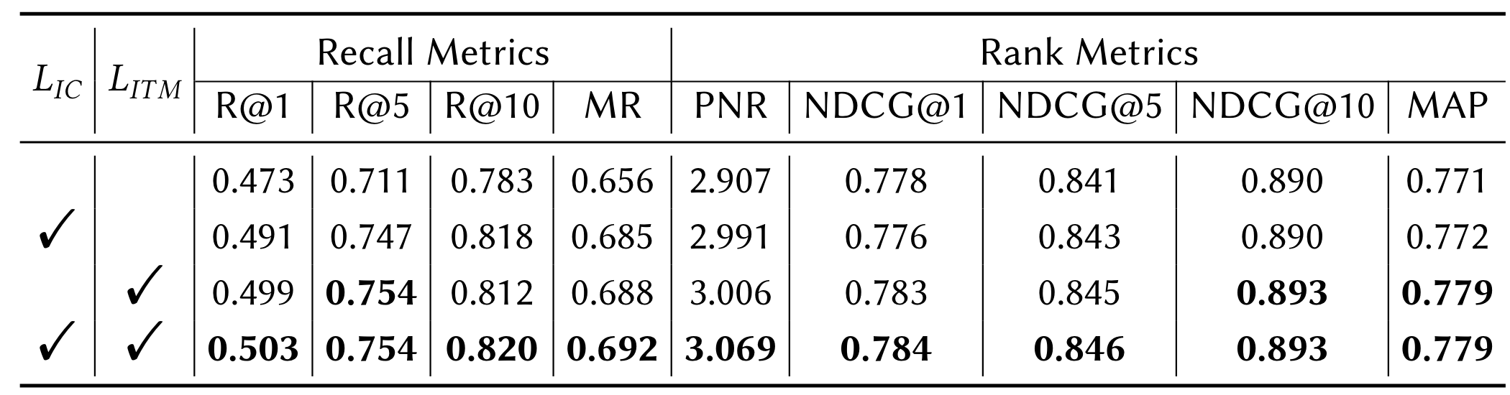
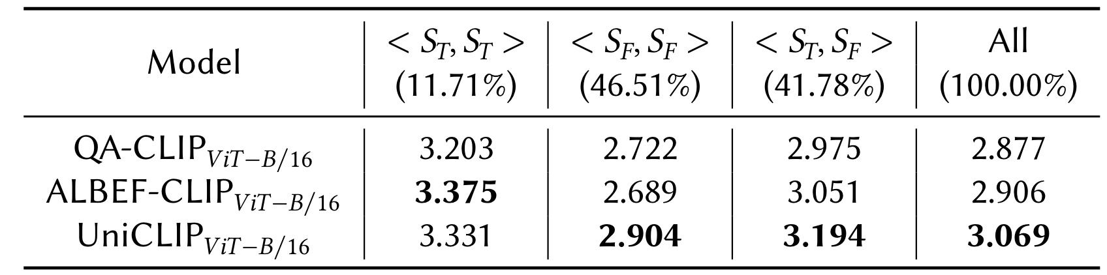
Experiment
An explicit OCR fusion scheme,
which is denoted as ALBEF-CLIP
Evaluation on the CBVS-20K dataset. Our proposal achieves SOTA performance
Results of ablation study of UniCLIP
PNR metrics for different OCR texts combinations

Slide 7
Summary
We establish the first large-scale cover-text benchmark for Chinese short video search scenarios, which provides short video covers and real user queries.
we release the largest publicly available Chinese video cover-video title dataset to fill in the lack of cover data for short video search scenarios
We further build a manual fine-labeling video cover-user query benchmark test for short video search domain
2. We further propose UniCLIP, which integrates the semantic information of cover-texts
without increasing the inference cost, is uniform with and without cover text, and has the
advantage of online deployment
3. We believe CBVS could further facilitate advanced research in short video search scenarios
https://github.com/QQBrowserVideoSearch/CBVS-UniCLIP

